Slide 1

JavaScript Chat Application
Dev: Kristiyan Petsanov
Mentor: Nadezhda Manchevska

Slide 2
Content
What libraries/tools were used in the development process?
What is the point of the application?
How can you access the app?
Application Overview
Live Demonstration
Conclusion

Slide 3
Libraries And Tools
FireBase was used to handle the back-end of the application
Page.js was used for the routing throughout the SPA
lit-html was used for rendering HTML templates
Webpack was used for bundling the modules/libraries into one file

Slide 4
What is the point of the application?
The point of the app is to show what you can do with just 2 months of studying how to create a JS application and basic knowledge of HTML and CSS.
In just 2 months you can learn how to make and end-to-end application with all the features that your everyday app has such as user profile, profile customization etc.
That’s exactly what I’ve done in the chat app. You can make your own account; you can create your own chats and invite your friends/co-workers by giving them the name and the password of your chat.

Slide 5
How can you access the app?
Link 1: https://krisdevbg.github.io/chatApp
Link 2: https://chat-app-22f2e.web.app/

Slide 6
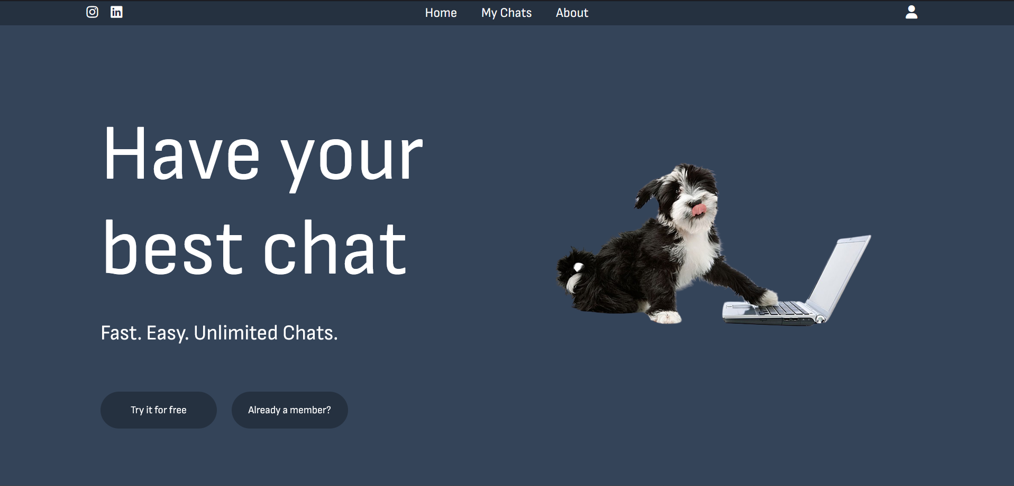
App overview – Home Page

Slide 7
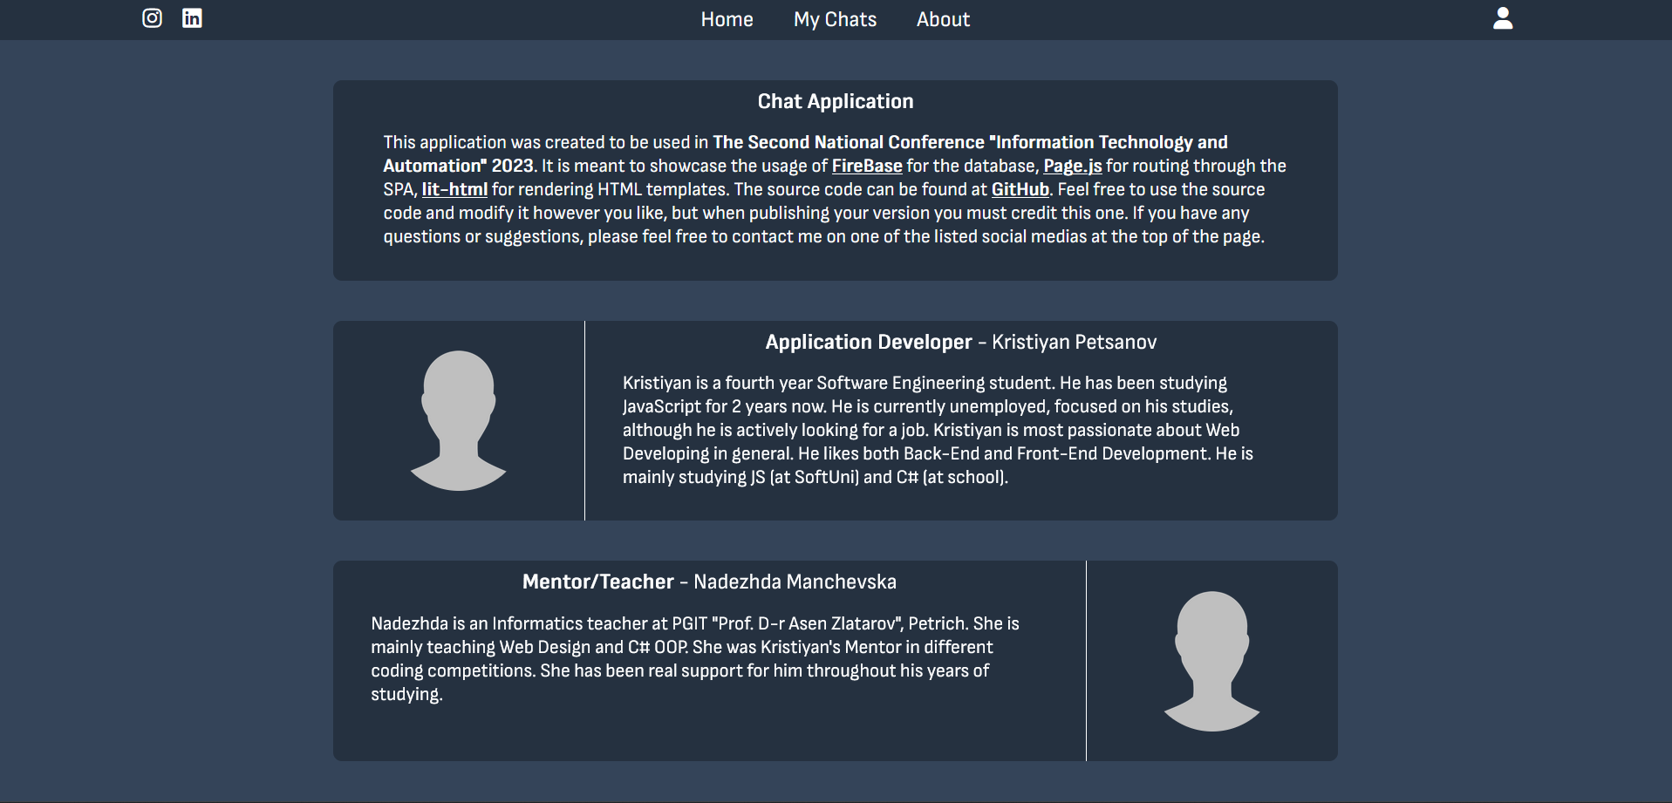
App overview – About Page

Slide 8
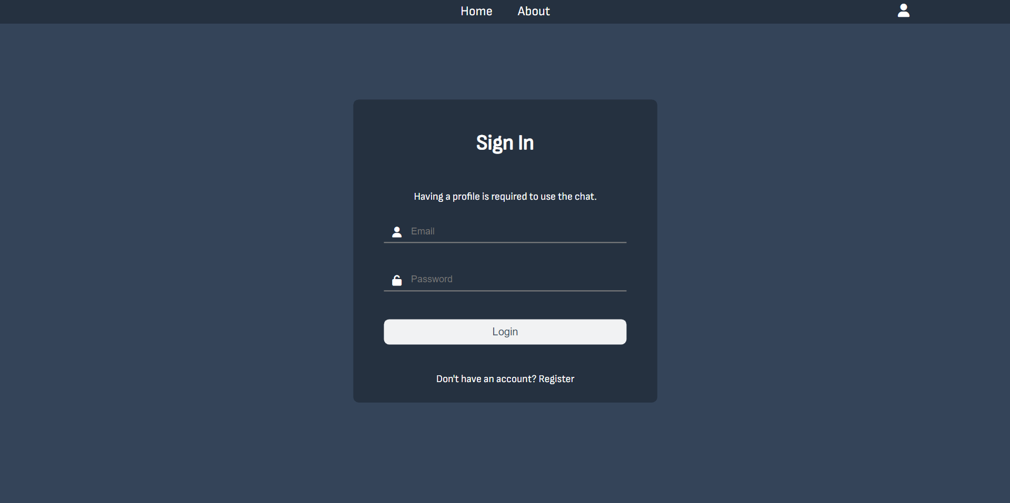
App overview – Sign In Page

Slide 9
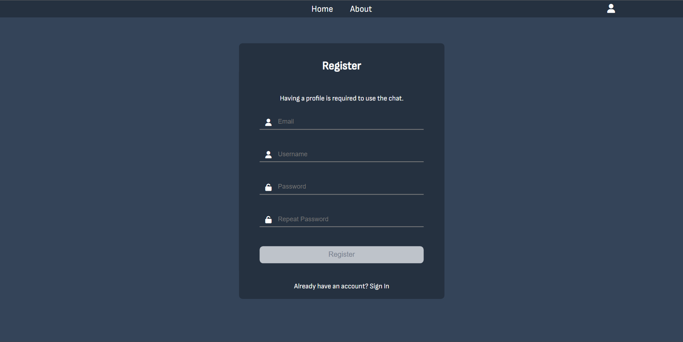
App overview – Register Page

Slide 10
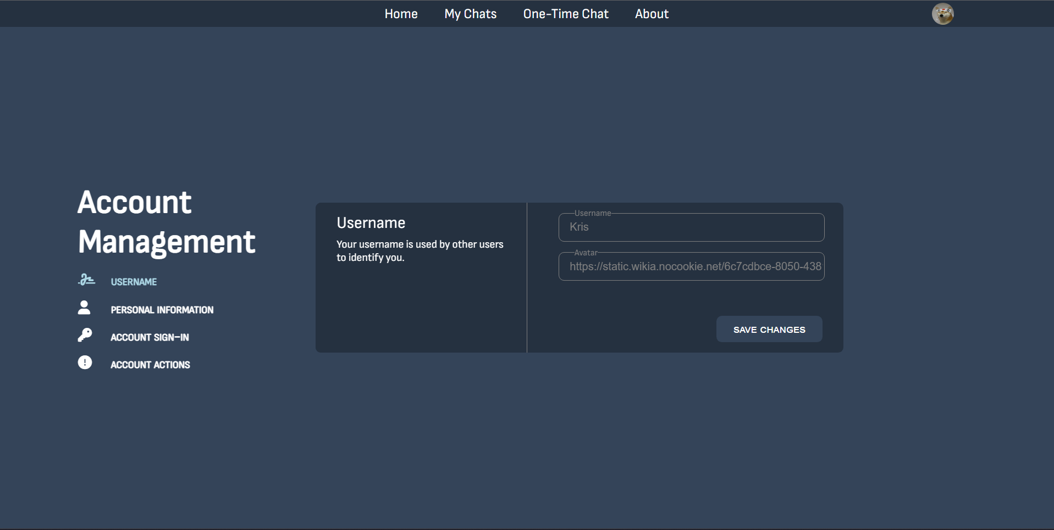
App overview – Settings Page

Slide 11
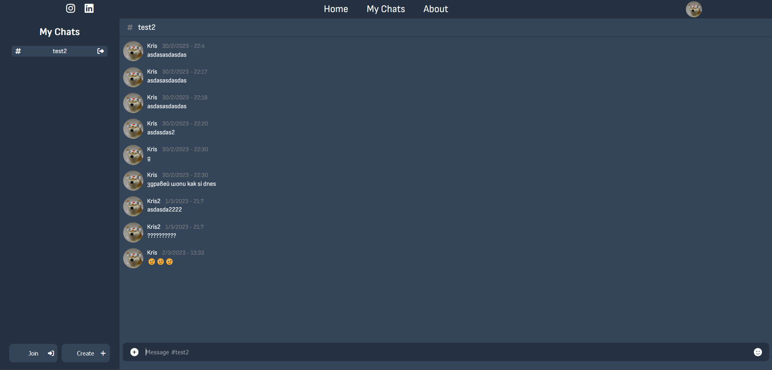
App overview – Chats Page

Slide 12
Live Demonstration https://krisdevbg.github.io/chatApp

Slide 13
Conclusion
Learning JS may seem hard, but it is like everything else. It will be hard in the beginning; however, it will be worth in the end.
If you are wondering whether to start studying any programming language or not, I suggest you start learning it, follow your dreams and NEVER Give Up.
Start coding today! ☺

Slide 14
Thank you for your attention!

